Slide 1
Topic-oriented Writing and Publishing (TOP)
Uta Bamberger, Structured Content Strategies
January 2010
[For internal use only]

Slide 2
Objectives/Agenda
Be able to explain:
  How TOP supports customer needs, company publishing goals and efficiencies, and strengthens the Symantec brand
  What a topic is; both in Vasont, and to a customer
  What different types of topics are and what they contain
  Titling guidelines and reasons behind them
  Best practices for cross-referencing between topics
  How to go about planning and managing topics

Slide 3

Why Topics?
Moving to a content management system
3
Notes:
3

Slide 4


Web 2.0 and structure 2.0
Web 2.0 changed our customers
They expect immediate answers
They use web search to get them
Our hidden answers have no value
We must restructure content into topics
We must restructure our delivery paths

Slide 5
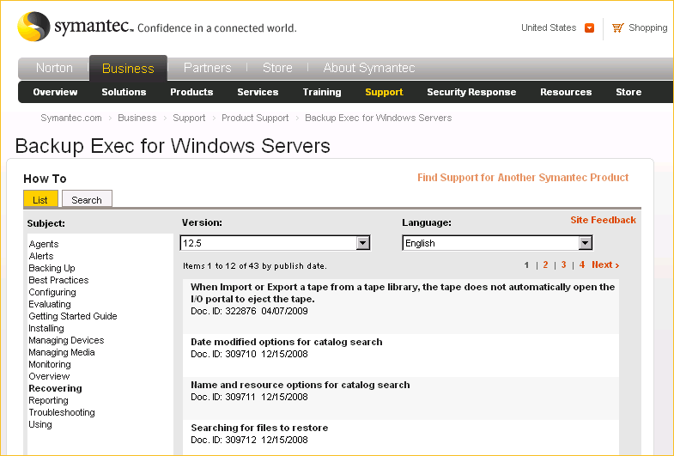
Knowledge Management
Topics published to Support site
Knowledge integration
Self Service
Search access
Browse access
Metrics show users
moving away from
books, toward topics
5

Slide 6
Topic Oriented Publishing (TOP)
Moving to a content management system
6
Notes:
6

Slide 7
About topic-oriented publishing (TOP)
Modular way of creating content that supports a unified content strategy
  Write once; use many times
  Write topics, not manuals
Based on research that has been conducted over several decades
  Started in the 1960s at aerospace companies; honed and developed in technical fields for decades
Industry standard for many major companies that have content management systems
  We are industry leader; we provide workshops at best practices conferences
Mission-critical for delivering high-quality, cost-efficient, and Web-ready content—and staying competitive!
  Supports reuse
  Makes localization cheaper and faster, so that we can sell in more markets
  Publishing topics to the Web makes it easy for users to find the exact information they need when they search
7
7
Notes:
7
The “TOP” in “symTOP” stands for Topic Oriented Publishing

Slide 8
TOP represents a new publishing paradigm
Content is modular (module = topic)
  Each topic answers a single question
  Each topic must be able to stand alone (think of a Web page that comes up in search results)
Related content is connected using cross-references
  Moving away from purely linear book outlines
  “Topic clusters” are sets of related topics that are linked by xrefs
Content is created and stored independent of formatting
Flexible output options maximize reuse
  Any topic can be used in any type of output (PDF, help, online, etc.); we can add new output types as formats evolve without modifying the content
  A single topic can be reused in as many deliverables as relevant
Content is separated by type into task, concept, or reference topics (DITA standard)
  Provides focus and easy access to the specific info a user needs
  Avoids mixing and potentially burying info
Notes:
Never depend on the context in which a topic appears in a particular deliverable. On a web page, user can’t scroll down to next topic the way they can in a PDF; they don’t have TOC pane the way they do in a CHM. Yes, a user may want to access additional topics with information that is related to the topic, so the topic should include cross-refs to all related topics to let the user know that the other topics exist, and to let the user access the other topics with one click.

Slide 9
TOP supports task-oriented, user-centric writing
Goal is NOT to document the product UI
Goal is to
  Document the tasks that users must perform to use the product successfully
  Focus on the highest priority content first
“It’s not what the software does (or looks like), it’s what the user does”
Notes:
Users don’t ask “what options are available on the policies menu?”; users ask “How do I create a policy?”; “How do I view existing policies?”; etc.
Topics that answer users’ questions should be our top priority.

Slide 10
TOP supports Web-based publishing
A connected world has changed our customers
  They expect immediate answers
  They use Web search to get them
Answers that are “hidden” in PDFs have less value: “If you can’t find it, it doesn’t exist”
  Content is unavailable to Google search
  Customers don’t look on the CD/DVD
  Customers end up calling support
Web publishing is the future of publishing
  Site metrics from Atlas (our current support site database) show that users prefer topics to PDFs
    E.g., for BEWS, metrics show a 26-to-1 preference (measured in hits and downloads)
    Users are trying to find the answers to questions, not manuals
InfoDev writes topics that are
    Published to the Symantec support site individually
    Assembled into Help systems
    Assembled into traditional deliverables such as PDFs
Notes:
PDFs aren’t going away any time soon, but they are becoming less important. Because we can so easily assemble topics into an outline structure and publish them as PDFs, we essentially get the PDFs as a bonus, without a lot of additional effort.
You can definitely create a satisfactory, usable PDF using only topics that are written to work also as standalone topics. You don’t need to include transitional sentences such as “in the next section we will discuss…” or “in chapter two you will learn…” – if users need to know that the other info exists, just add cross-refs to the other topics. In our system, we can never know for sure whether a particular topic will be in “chapter two” or not: that is certainly not the case on the support Web site.

Slide 11
Web Publishing: On the Horizon
Our new support database (Inquira) will do the following:
  Serve individual, searchable topics to users
  Make relevant content easy to find
  Provide localized topics
  Provide metrics to InfoDev on
    Which topics are accessed most often
    How helpful each topic is to users
Inquira metrics will help writers to
  Concentrate on the content that customers need most
  Prioritize their work
    Update the topics that customers use the most (if a topic is rarely/never accessed, it can be given lowest priority)
    Publish new topics and fix errors as needed, without waiting for a new product release – content creation won’t stop when the product is shipped
      Continuous publishing model
Notes:
Inquira will go live in the first half of 2010. Inquira report card lets writers know what to improve and what to maintain
It can provide detailed metrics such as number of hits per topic, whether a topic is printed, whether a user looks at a topic for less than 30 seconds, and to send writers direct feedback from customers (“Was this topic helpful?”)
If we focus on publishing individual topics to the Web, they can easily be updated whenever needed, regardless of release schedules. This has tremendous potential to make our documentation more useful, valuable, and current to our customers.
When a topic is published to Inquira it will include topic-owner metadata, and infodev writers or managers will be able to get notifications when there is feedback.
Why is this discussion of Inquira relevant to our TOP training? Because it will provide with valuable feedback on a topic basis (not by guide/manual) and help us improve and prioritize our work.

Slide 12
TOP realizes economies
12
12
Cost savings in creation, localization, publication, and time to market
Reuse of single topics across deliverables, leverage through versions, and repurposing in different formats for different audiences
  The same topic can be published to the Web, Help, or PDF
  A topic is written once, and the same info doesn’t have to be updated in multiple places
  If one thing changes in the product, writers only need to modify one topic and reviewers only need to review one topic
Localization savings
  Every English language topic can potentially be translated into more than 30 other languages
  If each topic is translated only once, we save time and money and may be able to sell the product in more markets
  If we translate topics as they are ready, localized deliverables can be shipped sooner
Notes:
12

Slide 13
TOP prevents typical pitfalls
13
13
Avoids redundant work—writers creating the same or overlapping content
Prevents the inclusion of irrelevant content that can distract and confuse the user
Prevents complexities due to lack of focus, non-conformity to standards, and inconsistency, which are passed on to the user
Prevents the misapplication of a linear information design that may not correspond to the user’s needs
Prevents information from being buried in long monolithic documents
Prevents the creation of silos of information that can’t be shared and reused by stakeholders
Notes:
Write only what the customers really need and will use (online stats help with that). We rarely have time to document everything before a release, so we should prioritize on our customer’s highest needs.
User’s want answers to questions
They don’t want to read novels –it’s all about what they’re currently trying to do.
Keeps Symantec’s assets compatible (the same goal that we have with our software code) – can mix and match anytime. When we publish topics to the support site, for example, support personnel can use them instead of writing separate support topics.
13

Slide 14
TOP strengthens our brand
14
Focus on customer needs—content that meets customers’ needs means reduced number of support calls
Improved accuracy, quality, and consistency
Predictable output and navigation
Overall unified look and feel—even with diverse global community of content developers deliver “one voice” to your customers
Notes:
We don’t write this to amuse one another – we write it for the customer to USE
Better docs means we’re meeting customer’s needs > less support calls > better stock price and more money in our 401k!
More accurate
Better quality and consitency
Predictable output and navigation (know what to expect of a Admin Guide)
ONE VOICE

Slide 15
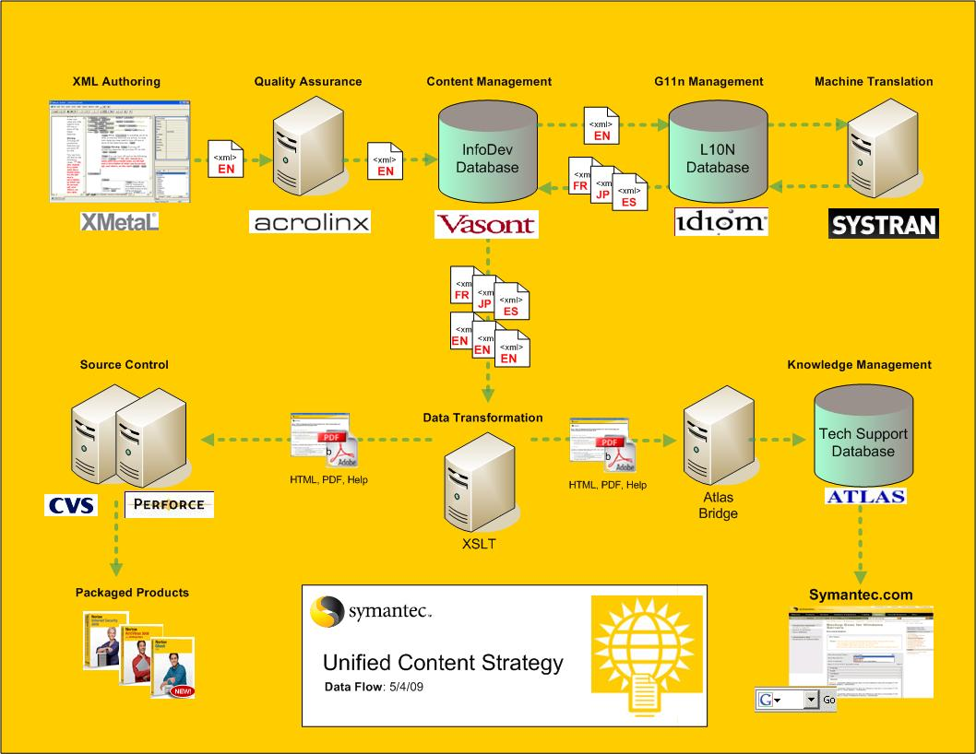
Information Flow
Notes:
UCS infrastructure Top row = UCS technology stack
Last 3 parts = “end-to-end” process
Support mission: Accelerate TTM with most efficient processes/technologies for publishing global content
Atlas will soon be replaced by Inquira

Slide 16
Quick Quiz: Topic-based publishing
You are talking with a colleague from another department and are asked about topic-based documentation.
Name 2-3 reasons for/benefits of TOP:
Notes:
Concept
2. Task
3. Reference
4. Process

Slide 17
Introducing
the Topic
Moving to a content management system
17
Notes:
17

Slide 18
About topics in general
A topic is the basic unit of reuse
  It’s the “module” in our modular TOP model
A topic has the following characteristics:
  Answers a single question or focuses on a single idea
  Can be accessed individually (must be able to stand alone)
  Has cross-references to related information
  Has a recognizable, predictable structure
Notes:
Key slide: this list of topic characteristics explains the nature of a topic in a concise summary.
We’ll be learning more about what the specific structures are a little later.

Slide 19
About topics in general (cont.)
Structure content according to the following principles of learning theory and effective technical writing:
  People process information in small manageable units
  Writers need to create and label manageable units of content
  Every content unit needs to focus on one idea
  Every piece of info in a unit must be relevant to the idea

Slide 20
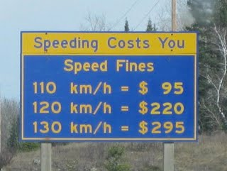
Examples of topic types
A non-technical example follows:
Concept | About speed limits
Task | Installing a radar detector
Reference | Speeding fines
A technical example follows:
Concept | About the master server
Task | Configuring the master server
Reference | Parameters for the master server

Slide 21
About core topic types
TOPIC
Concept
Task
Reference
______________________
________________________
_______________________
______________________
_______________________
___________________
______________
______________
______________
______________
______________
Support
Core
Support
About the master server
Configuring the master server
Parameters for the master server
Provides conceptual background information that users need to perform tasks successfully
(What do I need to know about the master server?)
Provides the step-by-step information that users need to perform tasks successfully
(How do I install or configure the master server?)
Provides the data or reference information that users need to perform task successfully
(Parameters, logs, error messages for the master server)
Notes:
These weren’t developed by or specific to Symantec; these topic types represent standard topic models that are specified for structured writing in schemas used throughout the industry, including DocBook and DITA.
In task-based topic architectures, task topics make up the core while concept and reference topics are added specifically to support the tasks.

Slide 22
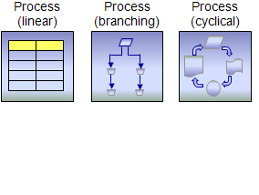
About the process topic type
Process topic is a content model developed by Symantec to meet a specific need
Process topic does the following:
  Provides an overview of complex processes that involve multiple tasks or phases
  Describes at a high level the tasks users need to perform to achieve their goal
  Ties together tasks to provide context for the reader. Readers understand why they would do a task and when to do the task.
  Does not include step-by-step instructions for any tasks; instead, includes cross-references to separate task topics
Notes:
We’ll learn more about each topic type in future slides.

Slide 23
Conforming to topic types
You use these topic types for all of the content that you write
  Man pages are an exception, because they, by definition, have their own pre-defined structure that must be adhered to
Choose your topic type or types based on the type of user question that you need to answer
  Depending on the nature of the feature, functionality, or user goal that you are documenting, you might create a concept, task, and reference topic, or just a single task topic might be adequate, or you might need a concept topic and several task topics

Slide 24
The Topic Types
Moving to a content management system
24
Notes:
Moving to a content management system: Justification to implementation
May 2-3, 2009
Uta Bamberger, Alexia Idoura, Katy Mullally
24

Slide 25
About concept topics
Concept topics serve the following user needs:
  Describe concepts, things
  Most often used by new users
  Skipped by experienced users
  More likely to be read while user is not trying to complete a task
By putting conceptual information in a separate topic
  Users can locate and access it more quickly
  Content developers can maintain it more easily
Notes:
The information in a concept topic may be relevant to multiple tasks. If the conceptual info is in a separate topic, you can add cross-refs to it in several task topics.
You’ll see a patterns to the slides here. We’re answering the following questions:
How does this kind of topic serve the user?
What user question does it answer?
What is the content model for the topic types?

Slide 26
About concept topics (cont.)
Concept topics answer the following types of questions:
  What is important to know about a particular thing?
  What does that thing do?
  How does that thing work?
  What is the difference between two things?
  How are they related or the same?
  What do I have to know before performing a task?
  How can I reach my goal?
  What do I need to do and when?
Notes:
Whenever you are writing a topic, or deciding what topics need to be written, always try to think about what questions the user would ask. This is useful because (as in earlier example), users don’t ask “What are the options on the policies menu” so, it helps you determine whether your topic is answering a question that users aren’t really going to ask.

Slide 27
Concept topic model
Concept topics contain the following content:
  Overview information (in paras, lists, and tables, as appropriate)
    Descriptions
    Explanations
    Definitions
  Diagrams or flowcharts (if relevant)
    For example, a network diagram
    Always use graphics sparingly, only when really necessary
  Cross-references to related topics
Concept topics don’t contain the following:
  Screenshots (usually)
  Procedures
  Reference information
Notes:
Graphics are expensive to localize.
Always adequately cross-reference every topic. This is essential to creating networks of related topic that users can access with one click.

Slide 28
About task topics
Task topics are the essence of user documentation
  They contain the step-by-step procedures that users need to follow to complete a task
  Task topics are the most common, most important, and most frequently used topics
Task topics serve the following user needs:
  Describe when, why, and how to do something
  Used by new users to learn how to do something
  Referenced by experienced users to remind themselves how to do something or to make sure they don’t forget a step
  Most likely to be used while user is trying to accomplish task
  Easy to skim — they are used, not read
Notes:
If you need to provide significant amount of background information about the when and why, you can put that in a separate concept topic (if so, be sure to include cross-references in each topic to the other!)

Slide 29
About task topics (cont.)
By putting procedural information in a separate task topic
  Users can locate and access it directly
  Users can focus on procedural details to complete the task quickly
  Content developers can maintain it more easily
Task topics answer the following types of questions:
  How do I do something?
  Why do I do something?
  When do I do something?

Slide 30
Task topic model
Task topics always contain the following:
  Some introductory conceptual information to put the task into context (in paras, lists, and tables as appropriate)
  Procedures (a task topic is the only topic type that includes procedures)
    If it has a procedure, it’s a task topic
    If it doesn’t have a procedure, it’s not a task topic
  Cross-references to related topics
Task topics can contain the following:
  Screenshots (sparingly)
    Do NOT routinely add screenshots to procedure steps
    Only use when absolutely necessary for clarity
Task topics do not contain reference information
Notes:
Remember, if you need to provide a lot of detailed background info, you can put it in a separate concept topic. Just don’t forget the cross-references between the topics!
If written to our standards for orienting users, procedure steps rarely need a screenshot to be clear to users. You don’t need to provide a screenshot of the screen, panel, pane, or dialog that user will be working in. They use task topics while they are performing the task, they can see the GUI for themselves.
As I’ve said before, graphics are expensive to localize: for each screenshot you take, localization may have to go in and take a corresponding screenshot of a localized UI in more than 30 locales!

Slide 31
About reference topics
Reference topics serve the following user needs:
  Provide information that is either rarely used or too detailed to remember
  Information is usually tabular
  Often used by more advanced users; they already know what to do with the information, they just need a quick lookup
  Most likely to be referenced while the user is performing a task; a lack of information often blocks them from completing the task successfully
By putting reference information in a separate topic
  Users can locate and access it more quickly
  Content developers can maintain it more easily
Notes:
Tabular info (that is, in tables): there is no rule that the info has to be in a table, but it is almost always most appropriate to use a table for this type of information. For example, error codes and descriptions; log files and their file paths. In a reference table, order items alphabetically or if you are documenting numerical error codes, numerically, to make it easy for users to scan for the item they need info about.

Slide 32
About reference topics (cont.)
Reference topics answer the following types of questions:
  What are the database table definitions?
  What are the log file locations?
  What are the specific requirements for fields in a UI (special characters allowed, maximum number of characters, etc.)

Slide 33
Reference topic model
Reference topics can contain the following:
  Introductory text to provide context
  Tables or lists
  Cross-references to related topics
Reference topics don’t contain the following:
  Screenshots
  Procedures
  Conceptual information
Context-sensitive Help topics are a special kind of reference topic
  For example, a dialog box has multiple options and a Help button; the Help that appears when you click that Help button is a reference topic with a table listing the options and their descriptions

Slide 34
Core topic types and their structures
Symantec deliverables include the following topic types which
  Represent specific information types
  Have recognizable, predictable structures
Concept
Task
Reference
Title
Title
Paragraph
of context
Paragraph
of context
1.
2.
3.
4.
5.
Certain structures,
based on topic type
Certain structures,
based on topic type
Notes:
The core topic types represent specific information types and have recognizable structures.
For example,
Every topic has a heading as a necessary component
Every topic should have a paragraph of body text explaining the reason for the topic, that provides context for the remaining information
Every topic will also include a specific type of information that is represented by certain structures (XML elements)
For example, conceptual information belongs in paragraphs and bullet lists.
Task information belongs in a procedure, which has numbered steps.
Reference information is collected in a table so it is easy to scan.
As you can see in these illustrations, without even being able to read what’s in the topic, it’s possible to determine what core topic type it is, based only on it’s structure.
In other words, the elements in a topic model indicate what kind of information is contained in the topic.

Slide 35
About the process topic
Describes at a high level the process users need to follow to achieve their goal
  Stages and descriptions
  Causes and effects
Outlines phases and ties together tasks, but in itself is not a task with the detailed information for all steps
Provides context for the reader. Readers understand why they would do each task and when to do the task.
Serves as a navigational tool, via cross-references, to the task topics and other topics with more detailed information
Notes:
Process topics do not include actual steps or reference information. They do, however, include cross-references to related topics. Those related topics are most likely specific tasks described in the process, conceptual information required to understand the process, and reference material used during the process.
Process topics can include flowcharts, illustrating how tasks fit together. Note: a flowchart is NOT the same as a decision trees. We’re only using flowcharts.
FLOWCHART Definition:
diagram showing sequence of actions: a diagram that represents the sequence of operations in a process (http://encarta.msn.com/dictionary_1861690521/flow_chart.html)
DECISION TREE Definition
chart of possible choices and results: a diagram set out like the branches of a tree that shows the consequences of a decision, each decision entailing a course of action that requires various other decisions (seems more appropriate for the planning topic) (http://encarta.msn.com/dictionary_/decision%2520tree.html)

Slide 36
About the process topic (cont.)
Answers the following user questions:
  How can I reach my goal?
  What do I need to do and when?
  Why is this process the recommended process?
  How does this process relate to or affect other processes?
  What does the final outcome look like?
  What are the consequences?
Notes:
So, when the user needs to do something complex, that actually requires them to complete multiple tasks, you present that high-level process in its own topic.

Slide 37
Process topic model
Process topics contain the following:
  Introductory text to provide context for the process (typically paras)
  Table (required; use <table>; can be 2 or 3 columns)
    Lists the stages/descriptions, causes/effects
    Includes cross-references to topics that cover the concepts and tasks involved
    If all tasks/phases are required or must be done in a particular order, use 3-column table and use the first column to number the tasks/phases
  Flowchart (optional)
    Used for cyclical or branching processes
    Shows step-by-step progression through a procedure or system, especially using connecting lines and a set of conventional symbols
    A flowchart will always be accompanied by a table in a process topic, for explanation and xrefs to related topics
  Cross-references to related topics
    Most cross-references are inline in table rows; they point to the other topics that are part of the process
    Can also have standalone cross-references (outside of table) that point to related concept topics
Process topics never contain procedures, screenshots, or reference information
Notes:
Intro can be as short or long as appropriate, can be just a para or two, or include a bullet list of considerations.
Table must be a complex table (uses table element, not informaltable element) with title and header rows.
A flowchart is a diagram, a simple graphic. It’s good for visual learners and provides overall information about the process. However, we want process topics to be hubs of navigation between task topics, so there has to be a way to include basic descriptions and links to other concept topics and task topics: that info must be included in a table.
Table description note:
Since the process topic is scalable, it can be used for long, high level processes as well as short, simple processes
Every process topic contains a table. You can use either 2 or 3 column tables
If the content contains a high level process that requires all steps, in the order listed, and especially if it has more than 3 phases, use a 3 column table (including a column for step/phase).
If the content contains a short, sweet process that contains only 2-3 steps, it doesn’t need the step/phase column, so you can use a 2 column table.
Ask yourself: Is the order important? Are any tasks/phases optional?
More details in following slides

Slide 38
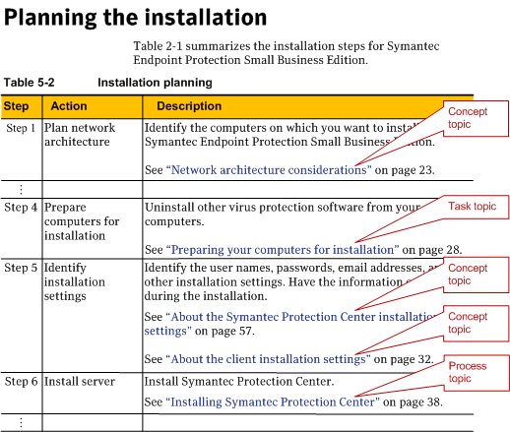
Sample process topic table
Notes:
Notice that a step or phase of a process can
Have xrefs to multiple topics, if appropriate
Actually be another (sub)process. For example, Planning for Installation includes a step for the actual installation. The installation itself is complex (e.g., multiple components are installed separately), so those installation topics have their own process topic, Installing the product, with links to the specific task topics that explain how to install each component.
Tip: If one of the steps or phases of your process topic includes a lot of explanatory info and multiple links to task topics, that might indicate that you need to write a separate process topic to hold that info and those links. Then the original process topic can link to the new process topic.

Slide 39
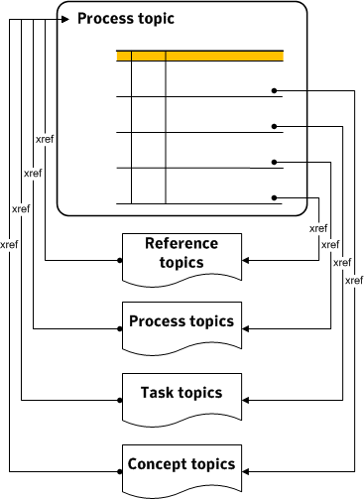
Cross-referencing to and from process topics
Notes:
This shows how process topics and related topics are linked.
Note that each topic (concept, task, reference, or process) that is referenced in the process topic has a link back to that process topic. For example, a specific installation task topic should have a cross-reference to the process on planning the installation, so that a user knows that there is a planning process that they may need to review first, or so that a user in the middle of the process can easily navigate back to the process topic to see what the next step in the process is as they work.

Slide 40
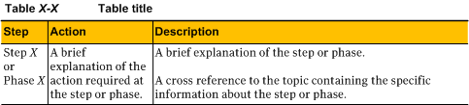
Components of a process topic table
Description:
Specifics about the task/concept
Action:
Use an imperative phrase
Step:
Use the word step or phase before the number. Numbered lists are reserved for procedures.
Notes:
Re step column: You actually type in the step/phase number; it isn’t auto-generated. Keep this in mind if you are considering conditionalizing a phase (row); you could end up with a gap in the numbering if you don’t account for it.

Slide 41
Summary of topic type characteristics
Concept topics
  Describe ideas, things, user goals
  Most often read by new users and skipped by experienced users
  More likely to be read while user is not trying to complete a task
  Use paras, lists, and tables as needed; never contain procedures
Task topics
  Describe how to do something, step by step, in procedures
  Used by new users to learn how to do something; used by experienced users to refresh their memory of specific steps
  Most likely to be used while user is trying to complete a task
Reference topics
  Provide information that is too detailed to remember or rarely used
  Usually in tabular form
  Often used by advanced users who know what to do with the information
  Most likely to be used while user is trying to accomplish task and lack of this detailed info blocks them from completing it
Process topics
  Describe high-level processes involving multiple phases or tasks, which are presented in tabular form
  Do not include step-by-step procedures; instead, they include cross-refs to related tasks topics
  Most often read by users before they perform the tasks involved in the process
NOTE: All topics should be able to stand alone; always think about viewing a topic in isolation on a Web page. All topics should be adequately cross-referenced.

Slide 42
Quick Quiz: Topic Types
What type of topic should you create for each of the following types of information?
  Log files and their installation paths
  Overview of how product or feature works
  Step by step instructions on how to create a policy
  High-level information about a series of tasks that should be performed in a specific order to successfully configure a database
  Error messages with their descriptions
  Commands and their parameters
  Explanation of what a policy is and how it gets triggered
Notes:
Reference
Concept
Task
Process
Reference
Reference
Concept

Slide 43
Topic Titling Guidelines
Moving to a content management system
43
Notes:
43
We’re going to go over best practices for writing titles in general, and the specific rules for writing titles for each topic type.

Slide 44
About titles and labeling content
Effective titles are based on the following principles:
  Orient users; help them scan for the information that they need
    Think of newspaper headlines: you scan the headlines to find out what articles you want to read
  Are descriptive; address one specific question that a user might have, indicate the content that follows
    A user is trying to answer a question or solve a problem: can users tell by the title alone what question the topic answers?
  Present a concise summary of a topic’s content. Does it answer my question or do I have to keep looking?
  Are context free and don’t depend on topic content or other topics to make sense
    Think about seeing the topic alone on a Web page, instead of being a subtopic in a linear deliverable
  Facilitate accurate content retrieval for Web search engines
44
Notes:
There are some general guidelines for writing titles that are meaningful to our users. These guidelines come from come from basic writing principles. [pause]
Topic titles should be descriptive and answer a question the user has in mind. For example, “Using LiveUpdate” might be a meaningful title to a content developer who has familiarity with Symantec’s products and their features. However, a new user might be better served by a title like, “Keeping your computer protected,” which answers questions like, “What does this product do for me?”
You want the title to be a summary of the answer that’s contained in the topic, so that the user doesn’t have to read the whole topic to find it wasn’t what he wanted. The title should indicate what is to follow in the topic. [pause]
You also want titles to be context-free and not depend on other topic titles to make sense.
A topic stands alone and the title should make sense by itself
Context free titles make the content easier to find with Web search engines
To facilitate machine translation, titles must consist of 25 words or less exactly.
In old paradigm, you might have a heading such “About installation settings” and then have two subheadings “On Linux” and “On Windows” – in TOP, those are three separate topics, and a title such as “On Linux” cannot stand alone as it requires the context provided by the title of the topic “About installation settings”

Slide 45
About titles and labeling content, cont.
Effective titles help content developers to do the following:
  Take inventory of content assets
  Plan and design new content
  Stay focused on the topic they are about to create
  Quickly locate content in the CMS
Effective titles are essential to planning and tracking topics in the User Topic Matrix (UTM)
45
Notes:
Meaningful titles help you too: it is important for you to know by just a glance at the title what a topic is really about.
Good topic titles help you quickly identify your content in Vasont
Good topic titles help your team keep track of what is documented and what isn’t and can make planning and designing deliverables easier.
Good topic titles also help you stay focused on the type of topic you are creating – concept, task or reference
E.g., if a topic title is “Installing the server” you should be able to assume that it answers the question “How do I install the server” and includes a step by step procedure to do so. So if the topic doesn’t really contain that info, you can end up with a gap in your content.

Slide 46
The Dos and Don’ts of topic titles
Do start the titles with the most meaningful words so that users can easily scan for information
Do use vocabulary that is meaningful to users
Do write task-based, not feature-based titles
Do develop titles based on questions users might ask
Do make sure titles are unique* so that users can identify all of the content that meets their information needs
    * within the deliverable
Don’t write longer titles than necessary
Don’t go into too much detail (where, when, how, etc.)
Don’t write one-word titles
Don’t write titles in question format
Don’t write vague titles like “Using component x” or “Working with product name”
Notes:
There are some guidelines and best practices for writing good topic headings. [pause]
In general, when you’re writing topic titles:
Again like newspaper writing, you want to start the titles with the most meaningful words – users are scanning, not reading. [pause]
You want to use vocabulary that’s meaningful to users, who may not know the product as well as the developers. [pause]
You want to focus on task-based, not feature-based titles. E.g., [pause]
You want to develop titles based on the questions that users have in their heads such as “What do I do with this?” or “What does this mean?”.
***Focus on what the user is trying to do, not the name of the feature or the specific option of the feature that they need to use – the user probably don’t know what the feature is called yet or that it even has options. [pause]
You want to make sure titles are unique within a deliverable so a user can find the right topic to meet thier information needs. [pause]
Avoid writing long titles – one check is whether the title wraps to the next line in a PDF; this isn’t a hard rule, depends on the content. [pause]
That being said, try to avoid going into too much detail. [pause]
However, if you are using vocabulary that’s meaningful to the users, and you’re making sure your title is unique, it may turn out to be a rather long title. Acrocheck, the tool used to assist us in writing for machine translation allows twenty-five words total. Long product names with multiple words count as a single word. [pause]
On the other end of the spectrum, it’s best not to write a one-word title. The word “Databases” isn’t very meaningful to either a user or a content developer. [pause]
You don’t want to write titles in question format. [pause]
When developing a topic (especially when using the User-Topic Matrix tool) you want to identify the question a user would ask and use it as your focus for developing the topic to answer it. The question might be recorded in the User Topic Matrix or may even serve as a placeholder for the title while the topic is in development. However, once the topic is complete, the title must be written as a non-interrogative statement.
Lastly, avoid vague titles. [pause]
titles that contain vague gerunds, such as “using” and “working” aren’t effective because they do not provide enough information about what the user learn in the topic. Think instead at a more granular level: What, specifically, does the user want our product to do for them? What task are they trying to perform with our product? titles that answers these questions are more effective.

Slide 47
Topic title requirements by topic type
Concept topic titles
  Usually start with “About”
  Never start with a gerund
Task topic titles
  Always start with a gerund (“-ing” word)
  Users can tell at a glance whether topic will show them how to perform a task
  Procedure titles
    Always start with infinitive (To do something)
    Should be parallel to topic title: e.g., If topic is “Creating a policy”; then procedure is “To create a policy” (not “To add a policy”)
Notes:
Concept titles: Usually “About”, in fact this is so common that we sometimes colloquially refer to concepts topics as “about topics”. Other examples: “How <something> works”
Task titles: Remember, be as specific as possible. Avoid “Using” and “Working with”, which usually indicate a feature based rather than task based title. They can also indicate that you are trying to put multiple tasks into one topic that should be multiple topics.

Slide 48
Topic title requirements by topic type (cont.)
Reference topic titles
  Always start with a noun
    E.g.: Error messages during installation, Incident log files
  Never start with a gerund or “About”
  If it is a context-sensitive Help topic, the title should be the title of the dialog box
Process topic titles
  Always start with a gerund
    Even though process topics do not contain procedures, they answer a “how do I?” question.
  Both process and task topics should be returned in searches for “how do I” questions.

Slide 49
Quick Quiz: Topic Titles
Can you tell the type of topic from the following titles?
  1. About Microsoft Exchange recovery notes
  2. Restoring Exchange data
  3. Exchange mailbox access requirements
  4. Planning for Microsoft Exchange installation
Notes:
Concept
2. Task
3. Reference
4. Process

Slide 50
Cross-referencing Best Practices
Moving to a content management system
50
Notes:
50

Slide 51
Why cross-references?
Any topic can potentially be viewed by a user in isolation, out of context of other topics, depending on the type of output
  Topics may be a result of a Google search
  Topics can be viewed individually on the Symantec support site
  Topics can be searched via “Search” and “Browse” in symHelp
Topic-to-topic cross-referencing provides context and creates a network of content
Topic-to-topic cross-referencing also replaces references typical of a book paradigm such as
  “in the next chapter”
  “in the following section”
  “what’s next”

Slide 52
Guidelines for meaningful cross-referencing
Best Practices | Comments | Questions to ask yourself
Each topic must have at least one cross-reference to another topic. | At least one cross-reference must link to another topic. References within the same topic to a table or figure do not count as a topic-to-topic cross-reference. | Does my topic have at least one cross-reference to another topic? After reading my topic, what questions related to this information might my readers have?
Each topic must have at least one cross-reference pointing to it from other topic. | Links from other topics provide infomation to users they may not have known to search for. Without links from other topics, your topic may not be found. | What paths of inquiry might a user follow to this topic?
Cross-references generally belong at the end of a topic. | Cross-references can disrupt the flow of the topic. Readers might get confused as to how important they are and whether they should leave a topic to follow the cross-references. Putting cross-references at the end of a topic doesn’t disrupt the uptake of the main information in the topic. It is acceptable to list cross-references after a procedure in a task topic. Place cross-references following a paragraph only if the immediate context and proximity matter (consider 1 or 2 at a time). For example, a cross-reference from a task topic back to its related process topic must follow the introductory paragraph. | Where are the cross-references in my topic? Will the user think it's necessary to follow the link?
Use process topics to help the user navigate through multiple stages to complete a high level task. | Each step or phase of the process table contains a cross-reference to a related topic. Each task, concept or reference topic that links from the process topic must also link back to the process topic. | Is this task part of a larger process? What related conceptual or reference information does a user need to complete the task?
Not every topic needs to cross-reference to every other topic in a cluster. Avoid too many cross-references in a single topic. | Too many cross-references may distract the user or make it more difficult to scan and read your topic. Think about where they are in accomplishing their task and what information they really need. Also don’t include the same cross-reference twice within a topic. | How much of a user task is already complete? What is left to do? What does the user still need to know? How's the readability of my topic?

Slide 53
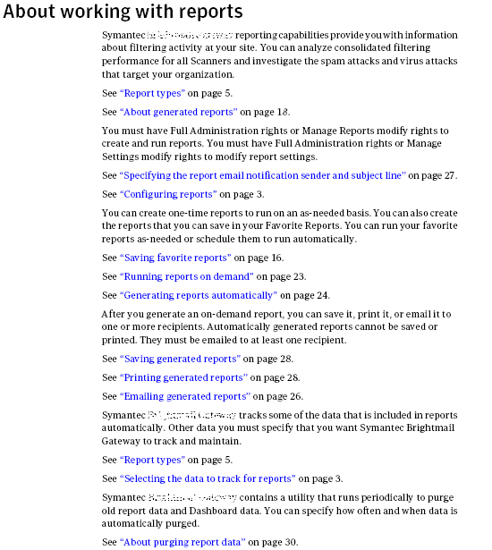
What to avoid: Example 1
Notes:
Avoid
* using the same cross-reference multiple times in a topic: instead place it once where it makes the most sense, either after a para or at the end of the topic
* using too many cross-references: instead decide which ones are relevant and remove the ones that are not critical
* using blocks of cross-references within the topic: instead place only a truly contextual cross-reference right after a paragraph and place a limited number of relevant cross-references at the end of the topic

Slide 54
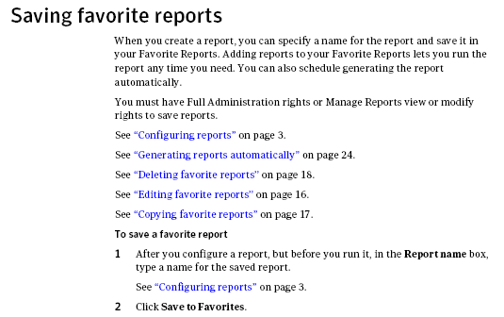
What to avoid: Example 2
Notes:
Avoid placing a block of cross-references for related information within the topic. Decide if contextual cross-references are needed right after a paragraph and place all or the remainder at the end of the topic.

Slide 55
Planning and Managing Topics Overview
Moving to a content management system
55
Notes:
55

Slide 56
Effective content requires planning
InfoDev needs to plan content early to ensure
Deliverables and support site are filled with needed, value-added topics users will want to read and use
Answers (topics) are quickly searchable through Google, Support site, and product Help
Topics anticipate information needs of customers by understanding user tasks and related questions
Notes:
in TOP environ, everything happens up front - need a tool that supports that - only place in workflow that addresses the topic based development of content. (PLC doc doesn't do it, Vasont can't do it, either - can't do your planning for you, just manages what you put in)
it's about up front planning - user questions, structured around tasks, know your users
seeing stand alone topic in source doesn't reveal whether it's a necessary topic.
development audit on topic is bout structure, not context.
next to plan context early on so del is full of needed, value added topics. - UTM
2 audits in del coll.
after 1st, structure can look good, but by the time you see it all hang together, it's too late to change it.

Slide 57
Tools and methods for managing content
CMS
  Storing and editing of individual topics (Source collection)
  Assembling topics into various deliverables (Deliverables collection)
InfoDev Plan for planning project (overall goals)
symTOP Web (formerly InfoDev Deliverables spreadsheet) for communicating deliverables to L10N
User Topic Matrix (UTM) for planning, designing, and managing content at the topic level

Slide 58
Managing content at the topic level
Topic title
Topic type
User question
Other optional categories and IDO related tracking
Inventory type organization principle
  Plan/track each topic only once
  List by component/functional area (not by chapter/deliverable)

Slide 59
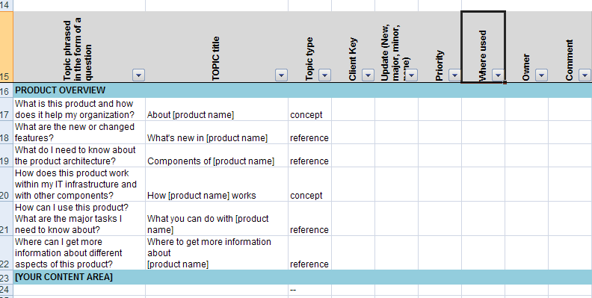
Current UTM master topic list view

Slide 60
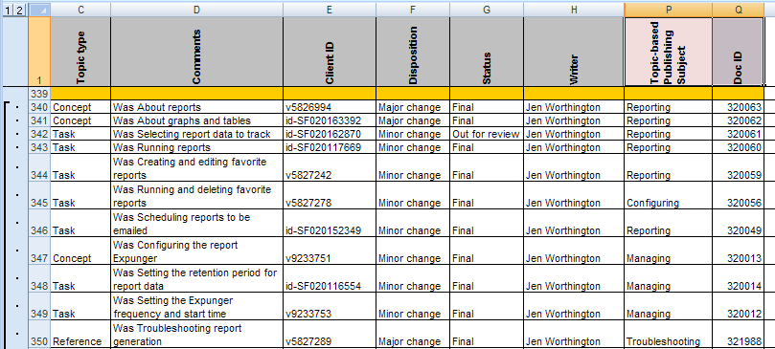
Brightmail example (IDO tracking)

Slide 61
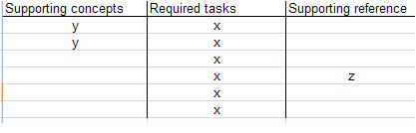
Planning task-based topic architectures
Understand high-level user tasks (key tasks)
List the individual task topics needed as well as the concept and reference topics to support these
  User roles help to refine what’s needed (advanced)
Use content models (for example, key task chapter) to flesh out topic clusters and design into deliverables
Add all new topics to master topic list

Slide 62
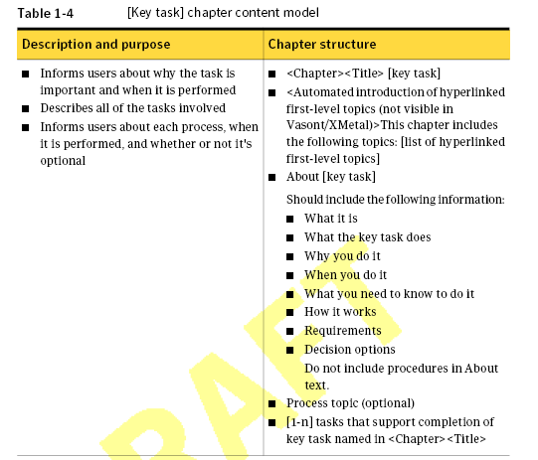
Example: Key task content model

Slide 63
Topification Checklist and More Examples
Moving to a content management system
63
Notes:
63

Slide 64
Topification checklist
Add inter-topic cross-references to all topics
  Includes x-refs after last step of procedures for task topics
Review topic titles
  Ensure they match the individual topic types
  Ensure that titles are context free and standalone
  Make them as unambiguous as possible
Ensure that the topic answers a valid user question (UTM column)
Check topic structure (each topic type has a specific structure). Add comment in UTM if fix needed (fix timeframe TBD).
  Ensure that topics have rich text introductory paragraphs to support web search tools
  Ensure that you have intro para for task topics (brief contextual info such as is task optional/mandatory, benefits/outcomes, when to do it, etc.)
  Ensure that there are no procedural elements outside of properly formatted numbered lists
  Ensure that user orientation only happens in procedures (not in body paras or titles)
Eliminate references to the “following chapter”, “previous section”, “this section”, etc.
Check for irrelevant/redundant/duplicate content. Eliminate or consolidate (examples: “What’s next” topics can be removed; Two topics with similar information can be consolidated into single topic.)
  Eliminate umbrella topics (typically single sentence H1 topics that introduce/support nested topics)
Refer to chapter content models for standard topics for certain topic clusters (introducing, installing, planning, key task)
Add at least one index marker

Slide 65
Task topics with multiple tasks
Examples of tasks that can be bundled into single task topic:
Enabling/disabling
Pausing/resuming
Creating/editing
Viewing/editing
Other?

Slide 66
Task topics with multiple tasks (cont’d)
Criteria for bundled task topics:
They’ll likely share the same contextual content in an intro para
They are related (complementary) and very short tasks
Navigation in UI is virtually identical
Ways to bundle:
Same procedure
Stacked procedures (use table/list with xrefs to procedures)
Topic titles
Titles should use “or” rather than “and” or “/”
Example: Enabling or disabling email notifications

Slide 67
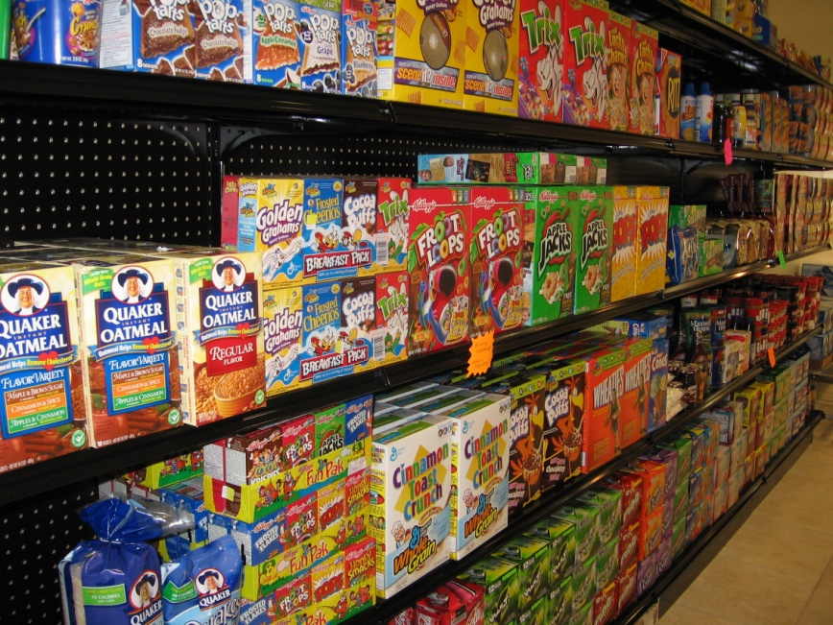
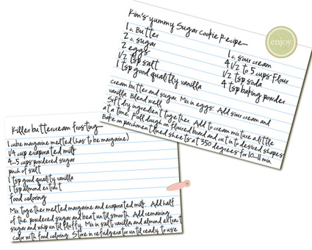
Source and Deliverables in Vasont
Source = grocery store
Deliverable = recipe

Slide 68
In other words…
"...Source bin structure could be thought of as aisles in a supermarket. The Deliverables bins would be more like recipes. That is, when you make a pie, you find butter in one aisle and flour in another, and fruit in yet another in the supermarket (Source), but the recipe (Deliverable) combines those items.
If you arranged the supermarket aisles to make it easy to gather the ingredients for a pie, it would not be as easy to grab the ingredients for baba ganoush."

Slide 69
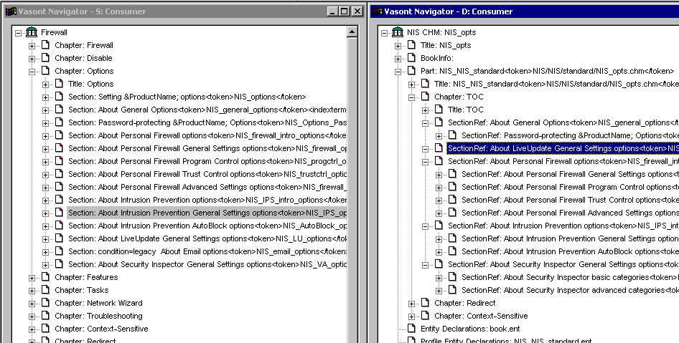
Source / Deliverable Structure
Flat source Nested deliverable
Notes:
Source structure is for the WRITERS – set up in a way that makes sense to them.
Subjects, component = source
User goals = deliverables
Aids “findability”
For content that could belong to multiple source bins, use annotations at chapter or book level (section level?)
Convenient when verifying deliverables
Vasont doesn’t automatically link a source topic to a deliverable, including nested topics.

Slide 70
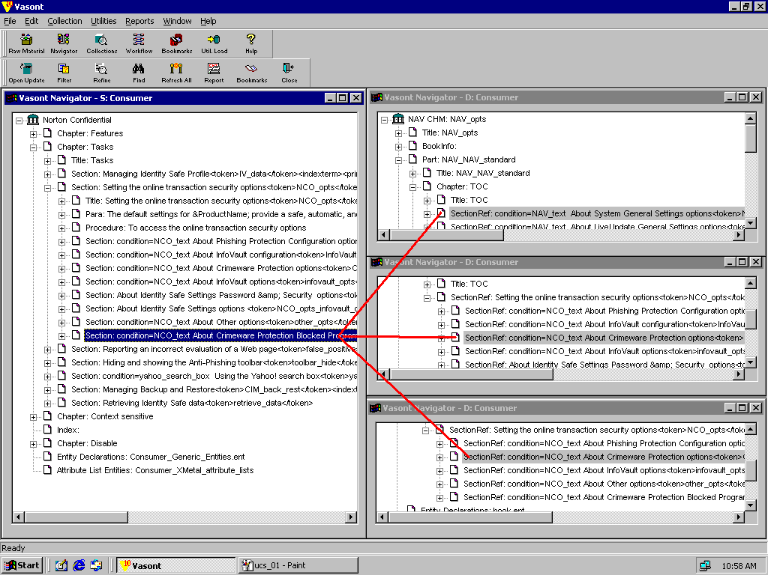
Topic reuse
The same topic in source can appear in many deliverables

Slide 71
Topic-Based Writing Additional Resources
Moving to a content management system
71
Notes:
71

Slide 72
TOP Resources—a short list
72
Intro to UCS (Karen Goldsmith, Director, Symantec Information Development): http://infowiki.corp.symantec.com/infowiki/index.php/Unified_Content_Strategy_(UCS)
Content models:
  http://infowiki.corp.symantec.com/infowiki/index.php/Content_Models
Topic templates in Vasont templates collection
Planning templates on Perforce (including UTM):
  //depot/Tech_pubs/_Project_Plans/_Templates/
Symantec User Centered Design user research (SURE):
  http://ucd.eng.symantec.com/Default.aspx
Ament, Kurt, Single Sourcing: Building Modular Documentation, 2003
Hackos, JoAnn, various texts and presentations on information development management
Horton, William, Designing and Writing Online Documentation, 1994
Rockley, Ann, Managing Enterprise Content: A Unified Content Strategy, 2003
Tripe, Bill, Topic-Oriented Information Development and Its Role in Globalization, The Gilbane Report, 2004
Weiss, Edmond H., How to Write Usable User Documentation, 1991

Slide 73
Questions?

Slide 74

Thank You!
Copyright © 2007 Symantec Corporation. All rights reserved. Symantec and the Symantec Logo are trademarks or registered trademarks of Symantec Corporation or its affiliates in the U.S. and other countries. Other names may be trademarks of their respective owners.
This document is provided for informational purposes only and is not intended as advertising. All warranties relating to the information in this document, either express or implied, are disclaimed to the maximum extent allowed by law. The information in this document is subject to change without notice.

